Slide 1


Global Climate Change
Week 3 - Radiation and the Greenhouse Effect
Dr Thomas Bannan
Thomas.Bannan@Manchester.ac.uk

Slide 2


Global Climate Change
Week 1 – Introduction to climate change and its impacts (5th Feb)
Week 2 – Natural climate variability (12th Feb)
Week 3 –Radiation and the Greenhouse Effect (19th Feb)
Week 4 – Anthropogenic Impacts (26th Feb)
Week 5 – The Evidence Base for Climate Change (5th March )
Week 6 – Mid Unit Test (10th March)
Week 7 – Climate Models (19th March
Week 8 – Climate change adaptation (26th March)
Week 9 – Effects of Climate Change: Case Studies (23rd April)
Week 10 – Climate change mitigation (30th April)
Week 11 – Revision Lecture (7th May)
Comments/Questions

Slide 3

Today’s class
  Part 1: Lecture and Workshops (80 mins)
  Part 2: Q/A (10 mins)
  Part 3: Full workshop (30 mins)

Slide 4

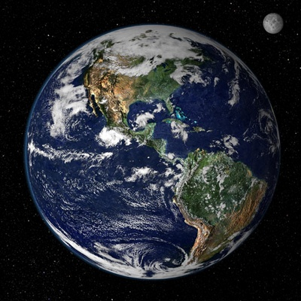
Last Week: Natural Variability
Solar Variability: Changes in the sun's energy output can influence Earth's climate. Solar cycles, which include variations in the sun's radiation and magnetic activity, can affect the amount of solar energy reaching the Earth.
Orbital Variations: Changes in Earth's orbit and axial tilt over long timescales, known as Milankovitch cycles, can affect the distribution and intensity of solar radiation received by the Earth, leading to changes in climate over tens of thousands to hundreds of thousands of years.
Volcanic Activity: Large volcanic eruptions can inject significant amounts of aerosol and sulphur dioxide into the atmosphere, leading to temporary cooling by blocking sunlight. These eruptions can cause short-term fluctuations in global temperatures.
Ocean Circulation: Ocean currents play a crucial role in redistributing heat around the Earth. Variations in ocean circulation patterns, such as El Niño and La Niña events in the Pacific Ocean, can have significant impacts on regional and global climate patterns.

Slide 5
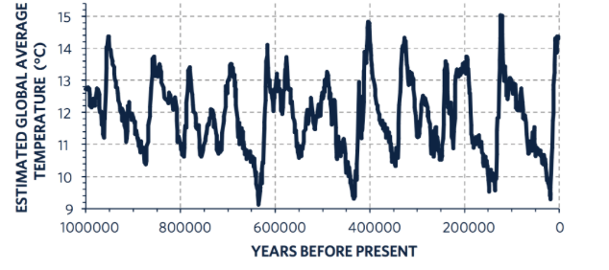
Last Week: Natural Variability

Slide 6
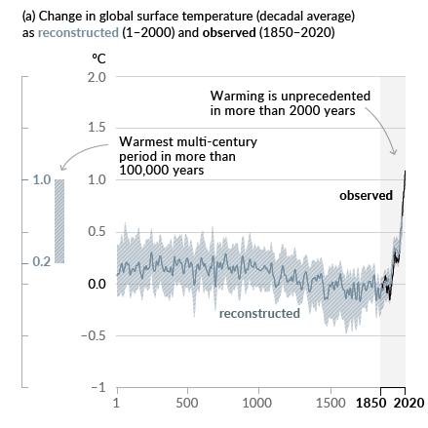
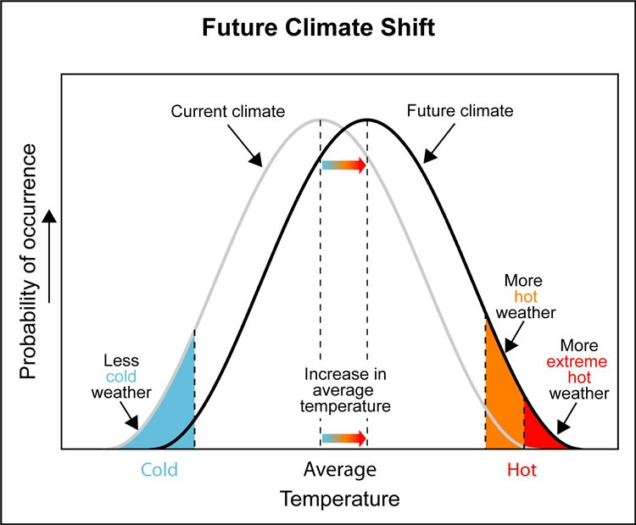
Week 1: Unprecedented Change: Why?

Slide 7
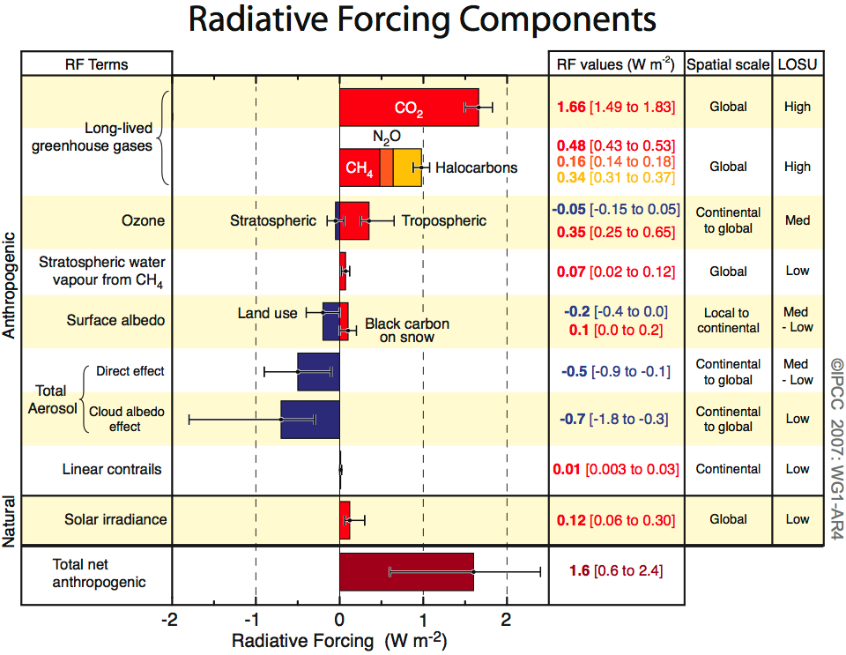
Week 1: Unprecedented Change: Why?

Slide 8

Intended Learning Outcomes
By the end of this lecture, you will be able to:
  Apply blackbody equilibrium and radiation laws to calculate the equilibrium temperature of Earth and other planets.
  Explain the physical basis of the greenhouse effect, including:
    why the radiation spectra of the Sun and the Earth differ, and
    why greenhouse gases interact differently with incoming solar radiation and outgoing terrestrial radiation.
  Use this understanding to explain why Earth’s surface temperature is higher than its blackbody equilibrium temperature
  Evaluate the implications of rising greenhouse gas concentrations
  Explain why increasing greenhouse gases are expected to drive further warming.

Slide 9
Greenhouse Effect
Solar radiation
high temp’ source
Short Waves
SPACE
Some of the infrared
radiation is absorbed
and re-emitted by the
greenhouse gases.
SUN
Some solar radiation is
reflected by the earth’s
surface, clouds and the atmosphere
This warms the surface and the atmosphere
Some solar radiation is absorbed by clouds and other gases
ATMOSPHERE
Terrestrial radiation
low temperature source
Long Waves
Most solar radiation
Passes straight through the atmosphere
and is absorbed to
warm the surface
EARTH

Slide 10
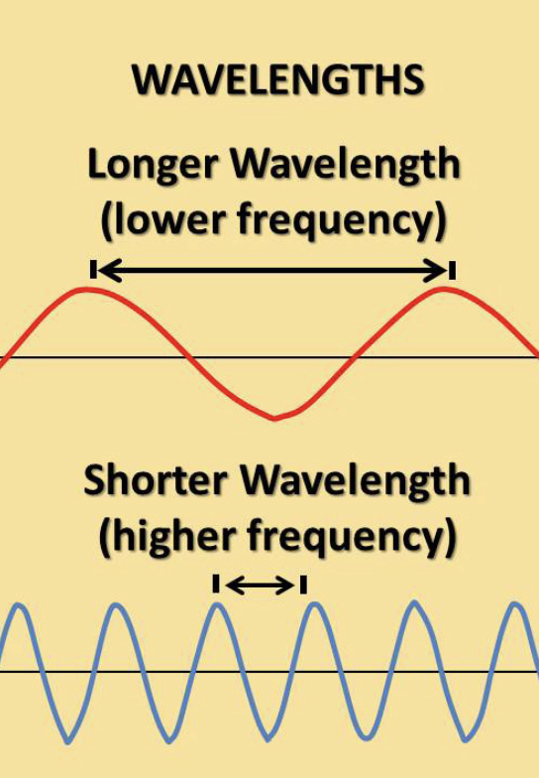
Electromagnetic Radiation
The energy from the sun is radiated or emitted away in the form of energy, known as electromagnetic radiation.
A particle of electromagnetic radiation is known as a photon.
Electromagnetic waves are characterized by wavelength and frequency.
The wavelength is the distance between two wave crests or troughs.
Frequency is expressed in hertz (Hz) and refers to the number of wavelengths that pass a fixed point in 1 second.
The shorter the wavelength is, the higher its frequency will be.

Slide 11
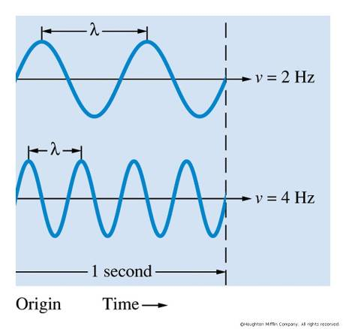
Electromagnetic Radiation
fλ= c
f = frequency
λ = wavelength
c = speed of light
Speed of radiation is a constant, but energy is not!
E = hf
E = Energy
h = Planck's constant (physical constant, that relates a photon's energy to its frequency)
f = frequency

Slide 12
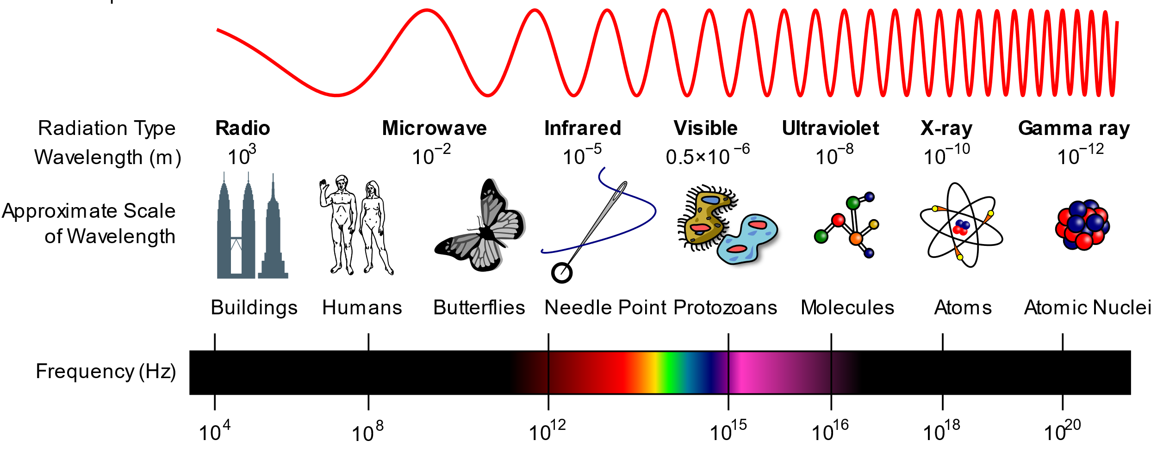
Electromagnetic Spectrum
The electromagnetic spectrum represents the complete range of electromagnetic radiation.
Any object warmer than 0 K will emit radiation.
The Sun radiates over the entire electromagnetic spectrum but as we shall see not all the energy is radiated equally at all wavelengths.

Slide 13
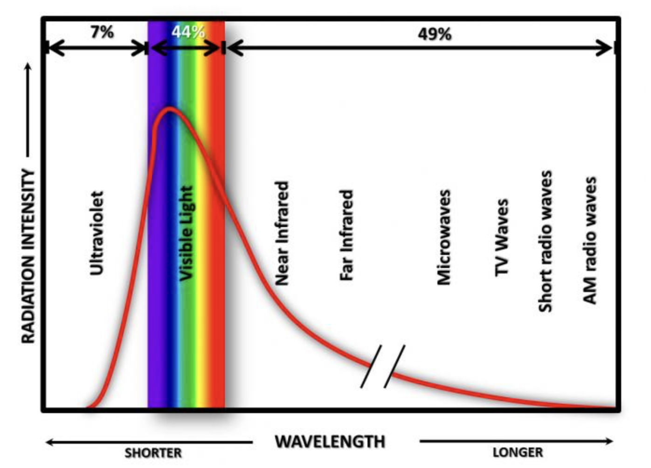
Electromagnetic Radiation
What emits radiation?
  All objects with a temperature greater than 0 K emit some type of radiation (energy)
  This is viewed as an energy spectrum
Radiation laws:
  Warmer objects emit more intensely than cold objects. (Stefan-Boltzmann Law)
  Warmer objects emit a higher proportion of their energy at short wavelengths. (Wien’s Law)

Slide 14
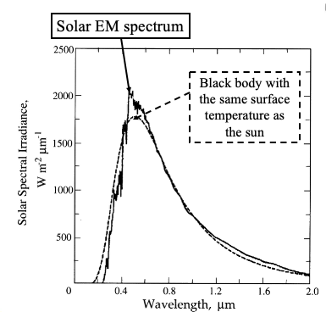
Blackbody Radiation
The Sun and Earth behave approximately like a black body
A Black body
absorbs all radiation falling on it...
...and reemits it as a function of its surface temperature
Governed by two radiation laws:
Stefan-Boltzmann law
Wien’s law

Slide 15
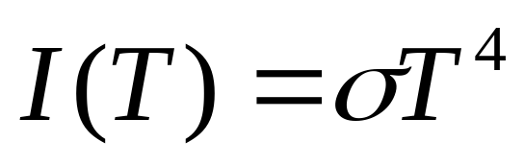
Radiation Laws
All bodies radiate energy as electromagnetic radiation.
A black body absorbs all radiation falling on it and it emits radiation as a function of its surface temperature.
Stefan-Boltzmann Law
Total energy is related to temperature by:
where:
I = Energy per unit area emitted per second (W m⁻²)
T = Equivalent black body Temperature (K)
σ = Stefan-Boltzmann constant (5.67 x 10⁻⁸ W m⁻² K⁻⁴)
Warmer objects emit energy more intensely than cold objects.

Slide 16
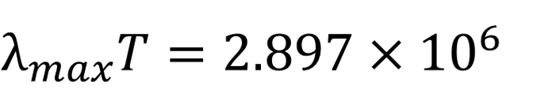
Radiation Laws
Wien’s Law
The wavelength which emits the most energy is related to temperature by:
where:
λ_{max} = Wavelength in nm
T = Temperature (K)
Warmer objects emit a higher proportion of their energy at short wavelengths than cold objects

Slide 17
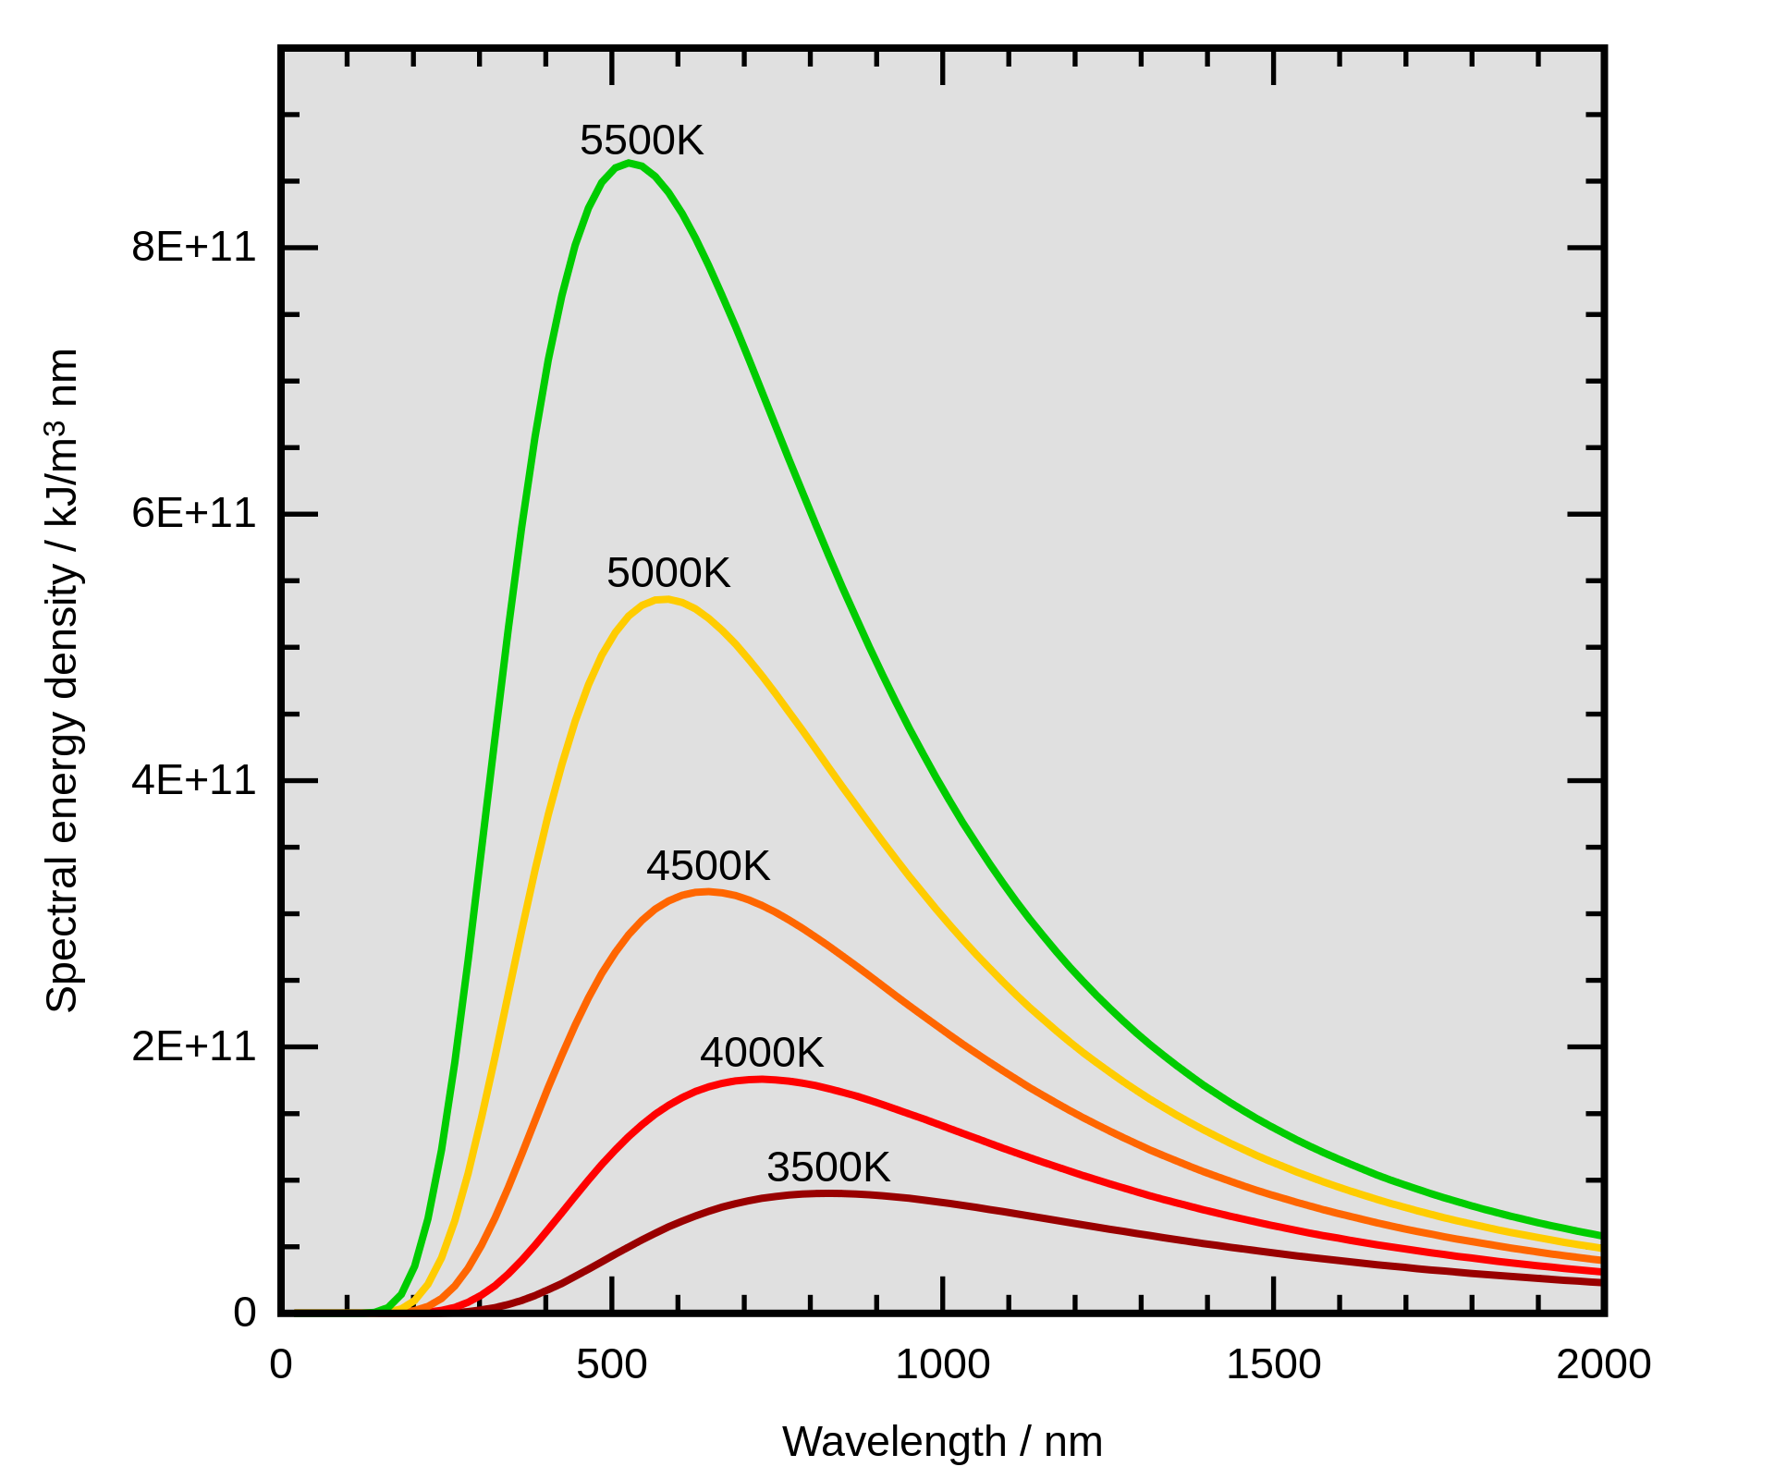
Radiation Laws Combined
As temperature increases:
Total energy increases
Peak wavelength decreases

Slide 18
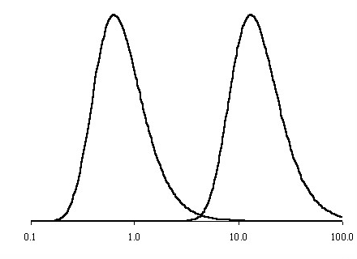
Terrestrial Radiation
The Earth also acts as a blackbody radiator
T_{e} = 288 K so most of the irradiance from the Earth is in the infra-red part of the spectrum and peaks at about 10 μm.
Solar Radiation 5900K Terrestrial Radiation 288 K
Wavelength μm

Slide 19
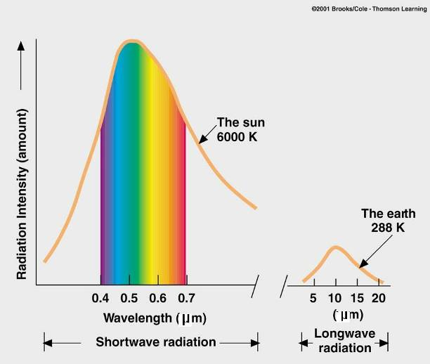
Solar and Earth Spectrums
As temperature increases:
Total energy increases
Peak wavelength decreases
Little overlap between the incoming solar radiation and the outgoing infra-red radiation from the Earth’s surface.
Separated by a gap at around 4 μm
SW
LW

Slide 20
Earth’s Energy Balance
Energy entering top of atmosphere
=
Energy leaving Earth’s surface
Temperature of surface remains constant

Slide 21
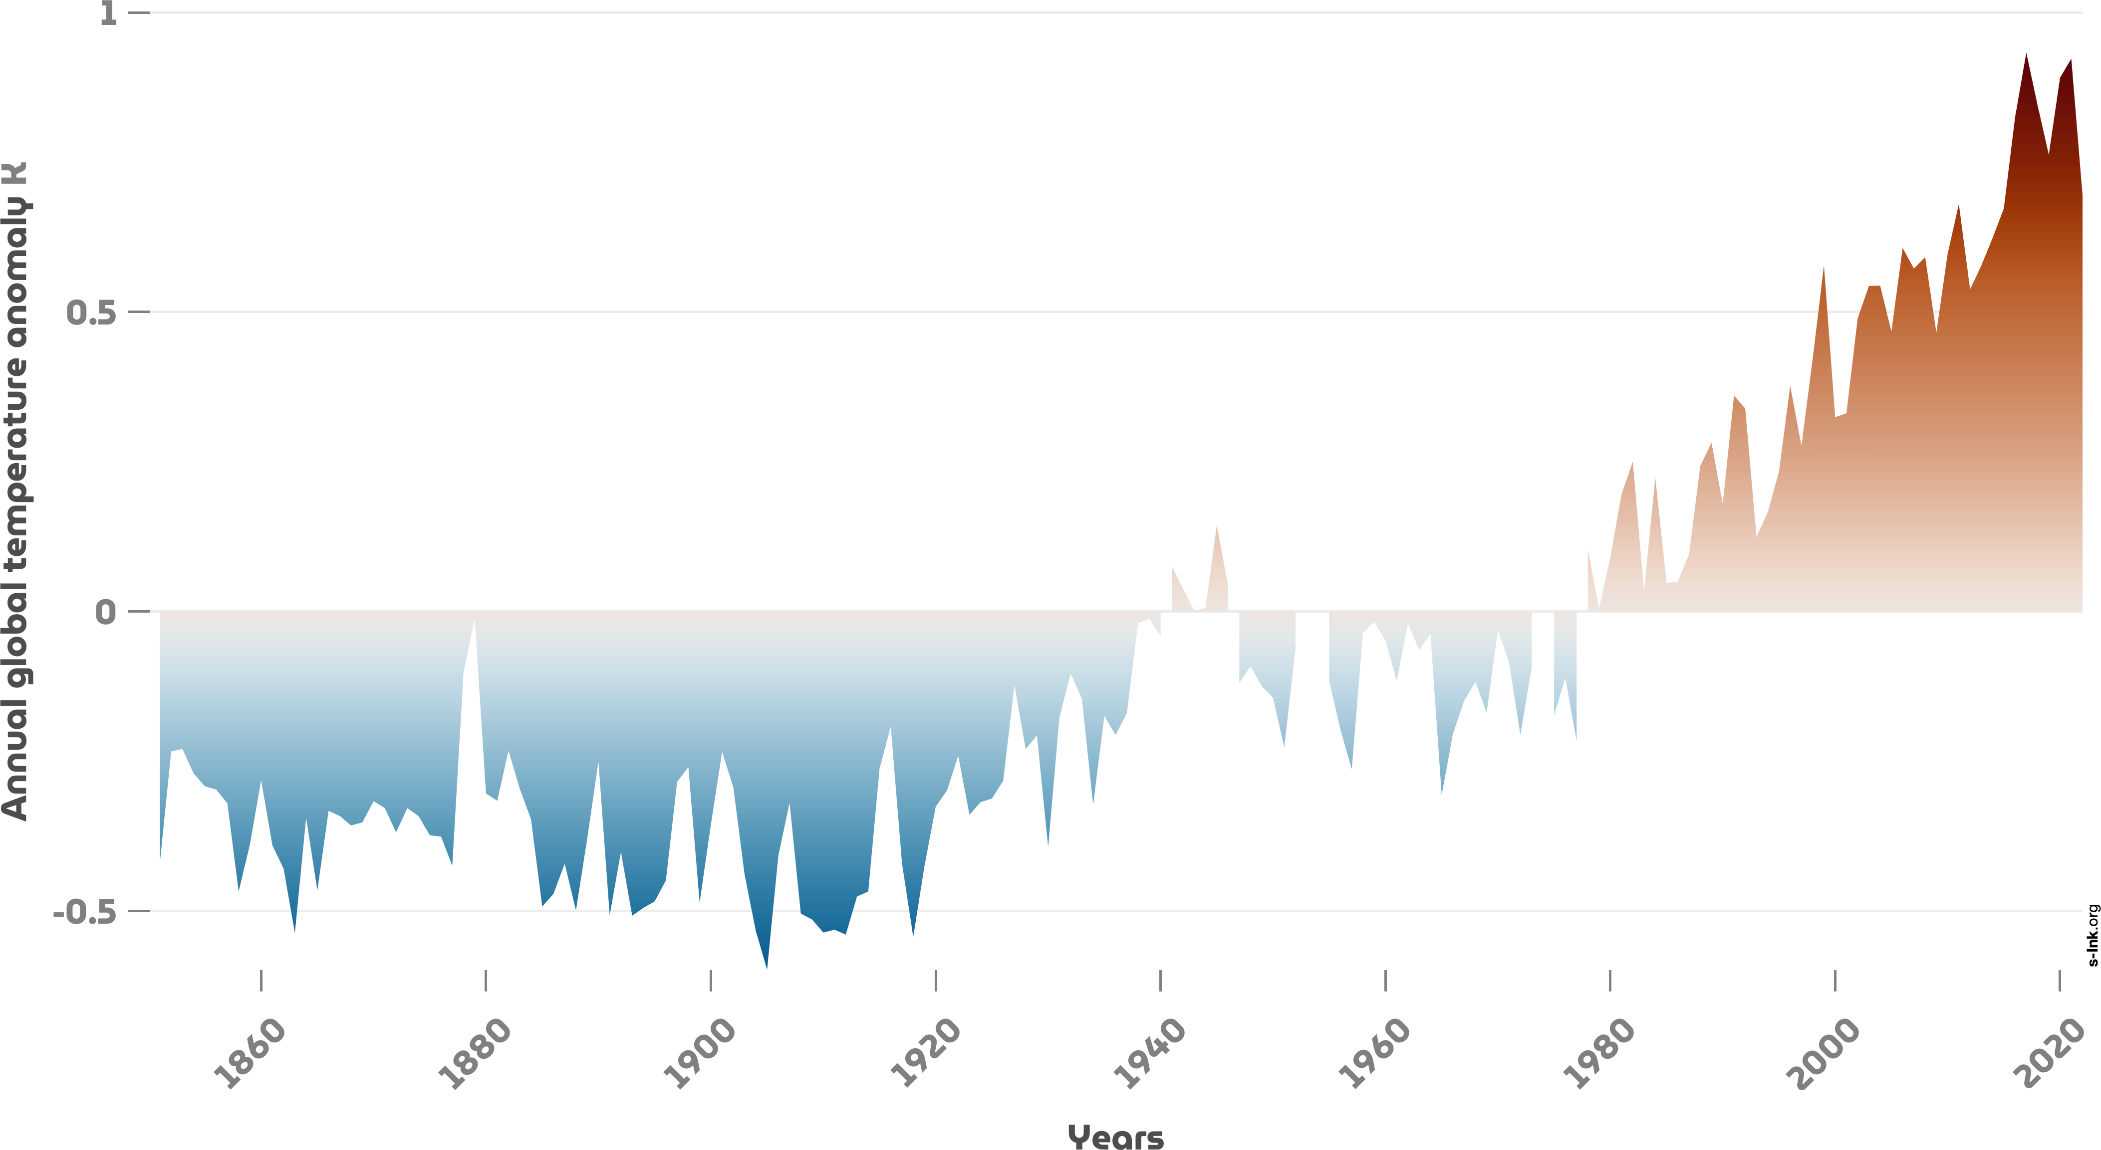
Energy Balance – Steady State Temp
T_{E} changes quite little from year to year → system is in equilibrium
i.e. energy inputs must be balanced approximately by energy losses.

Slide 22
Earth’s Energy Balance
Energy In: Incoming solar radiation = S_{o} x Area (A)
= S_{o} x πr_{e}²
Area of Earth perpendicular to solar radiation:
A = πr_{e}² where r_{e} = radius of Earth = 6370 km
Solar constant:
S₀=1370 W m²

Slide 23
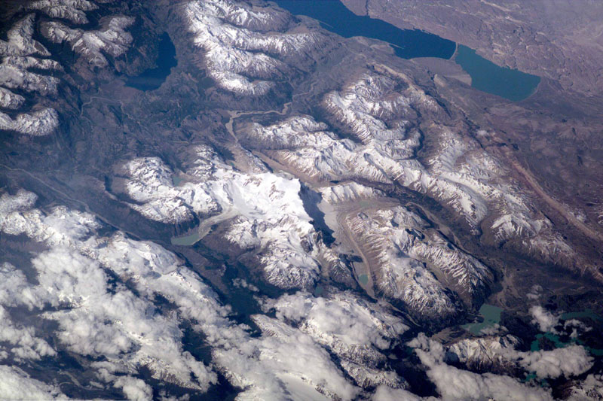
Earth’s Energy Balance
But some of the Sun’s radiation is reflected away!
Albedo (α): Fraction of energy that is reflected away
Dark surfaces have α ~ 0
Light surfaces have α ~ 1

Slide 24
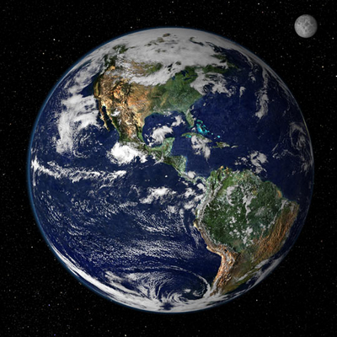
Earth’s Energy Balance
Albedo (α): Fraction of energy that is reflected away
Reflection of solar radiation
5% from land and ocean surface
20% from clouds
6% scattered by air
Total: ~30%
Land-use change driven by human activity modifies surface reflectivity, changing the proportion of solar radiation reflected back to space – Week 4

Slide 25
Earth’s Energy Balance
Energy In: Incoming solar radiation = S_{o} x Area (A)
= S_{o} x πr_{e}²
Area of Earth perpendicular to solar radiation:
A = πr_{e}² where r_{e} = radius of Earth
Solar constant:
S₀=1370 W m²

Slide 26
Earth’s Energy Balance
Energy In: Incoming solar radiation = S_{o} x Area (A) x albedo
= 0.7 x S_{o} x πr_{e}²
Solar constant:
S₀=1370 W m²

Slide 27
Earth’s Energy Balance
Energy entering top of atmosphere
=
Energy leaving Earth’s surface
Temperature of surface remains constant

Slide 28
Earth’s Energy Balance
Energy In: Incoming solar radiation = S_{o} x Area (A) x albedo
= 0.7 x S_{o} x πr_{e}²
Energy Out: Outgoing Terrestrial radiation = σT_{E}⁴ 4πr_{e}²
Surface area of Earth = 4πr_{e}²
Solar constant:
S₀=1370 W m²
σT_{E}⁴

Slide 29
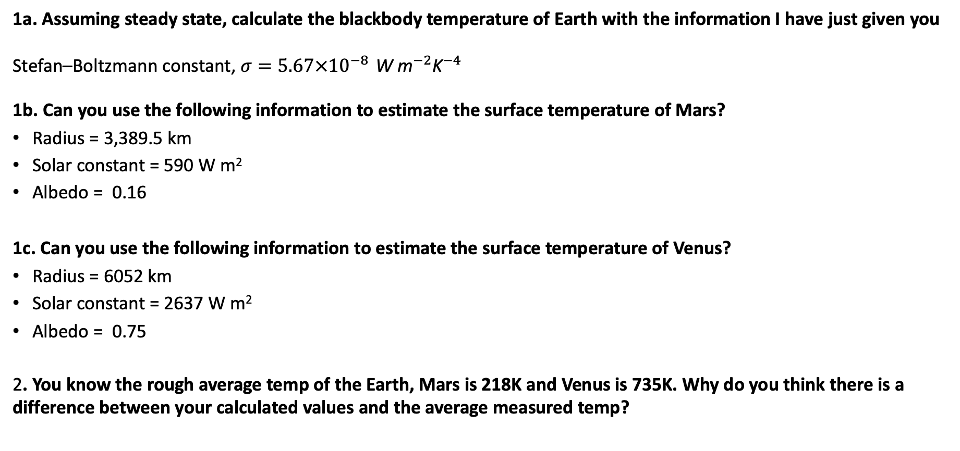
Workshop 1
1a. Assuming steady state, calculate the blackbody temperature of Earth with the information I have just given you
Stefan–Boltzmann constant, $σ=5.67×{10}^{−8 }{\text{W} \text{m}}^{−2}{\text{K}}^{−4}$
1b. Can you use the following information to estimate the surface temperature of Mars?
Radius = 3,389.5 km
Solar constant = 590 W m²
Albedo = 0.16
1c. Can you use the following information to estimate the surface temperature of Venus?
Radius = 6052 km
Solar constant = 2637 W m²
Albedo = 0.75
2. You know the rough average temp of the Earth, Mars is 218K and Venus is 735K. Why do you think there is a difference between your calculated values and the average measured temp?

Slide 30
Energy Balance - why is there a gap?
Energy leaving Earth’s surface
Energy entering top of atmosphere
=
If T_{e} = 255K (-18ºC), why is the global mean surface temperature of the earth actually 288K (+15ºC), why are we not freezing?!
Down to the different ways the atmosphere processes shortwave (solar) and longwave (terrestrial) radiation
The Greenhouse Effect:
Different molecules absorb radiation at specific wavelengths.
Several molecules in the atmosphere absorb strongly in the infrared → Greenhouse gases
The atmosphere is nearly transparent to SW radiation, but absorbs LW.

Slide 31
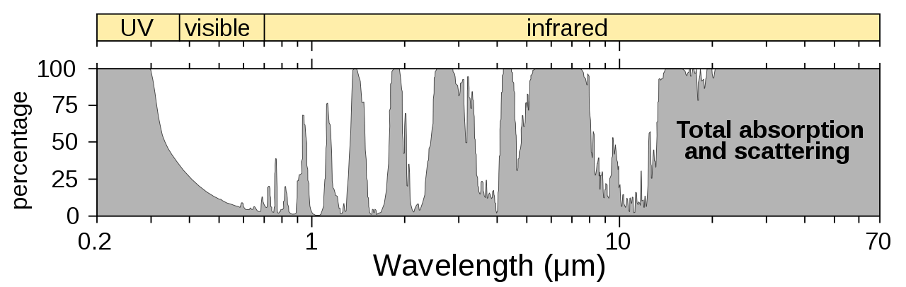
Energy Balance - why is there a gap?
Radiation is absorbed by the atmosphere......and reradiated in all directions
Radiation can go through: the atmospheric window

Slide 32
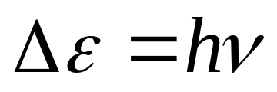
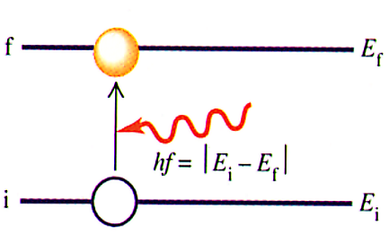
Energy Balance - why is there a gap?
For high energy radiation (<UV) a molecule can only absorb radiant energy if the wavelength of the radiation corresponds to the difference between two of its energy levels
For different molecules (of different composition and shape) the spacing between energy levels is different and so the absorption of radiant energy by molecules of differing structure occurs in different regions of the electromagnetic spectrum.
Absorption
The molecule is raised from state i to a higher state f by absorbing a photon whose energy is equal to
ΔE = E_{f} – E_{i} = hv

Slide 33
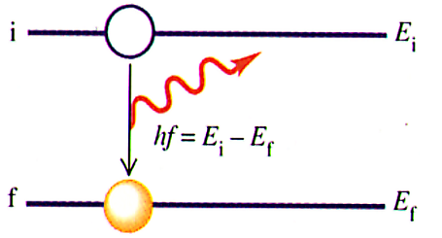
Energy Balance - why is there a gap?
For high energy radiation (<UV) a molecule can only absorb radiant energy if the wavelength of the radiation corresponds to the difference between two of its energy levels
For different molecules (of different composition and shape) the spacing between energy levels is different and so the absorption of radiant energy by molecules of differing structure occurs in different regions of the electromagnetic spectrum.
Emission
The molecule drops from a higher energy level or state to a lower energy state. It will emit a photon whose energy is
ΔE = E_{i} – E_{f} = hv

Slide 34
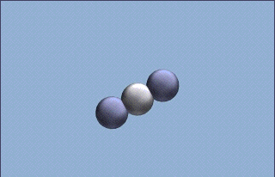
Energy Balance
For infrared radiation, there is not enough energy to change energy levels, instead molecules rotate, vibrate, stretch and bend, and then reradiate.

Slide 35
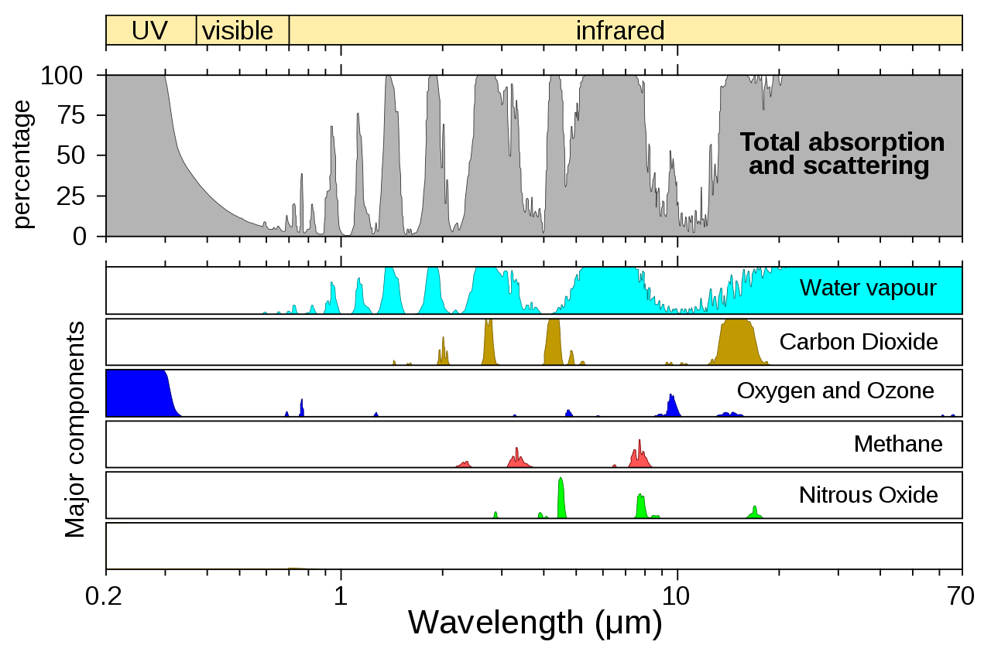
Energy Balance - Key Gasses
At sea level atmospheric gases have removed sections of the spectrum according to their absorption bands.
Note especially the strong absorption of infrared radiation by water vapour and carbon dioxide.

Slide 36
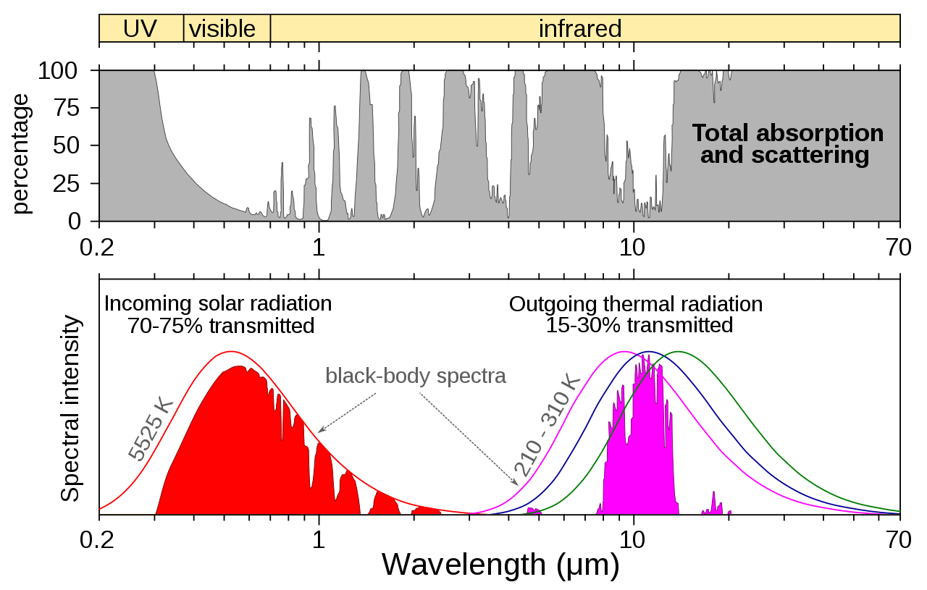
Energy Balance

Slide 37
Greenhouse Effect - Summary
Solar radiation
high temp’ source
Short Waves
SPACE
Some of the infrared
radiation is absorbed
and re-emitted by the
greenhouse gases.
SUN
Some solar radiation is
reflected by the earth’s
surface, clouds and the atmosphere
This warms the surface and the atmosphere
Some solar radiation is absorbed by clouds and other gases
ATMOSPHERE
Terrestrial radiation
low temperature source
Long Waves
Most solar radiation
Passes straight through the atmosphere
and is absorbed to
warm the surface
EARTH

Slide 38
Radiative Forcing
Definition of radiative forcing:
The change in radiation balance at the tropopause between the incoming solar radiation and the outgoing earth’s radiation (net irradiance).
Significance:
Increase in greenhouse gases has reduced the amount of longwave radiation leaving the troposphere –positive radiative forcing.

Slide 39
Greenhouse Effect - Summary
Some solar radiation absorbed by earth’s surface and atmosphere.
Earth and atmosphere emit infrared radiation.
Greenhouse gases absorb some of this infrared radiation.
Greenhouse gases (water, CO₂ + others) give off infrared radiation in all directions.
Earth absorbs downward directed infrared radiation
Result: warmer surface temperature = 288K rather than 255K

Slide 40
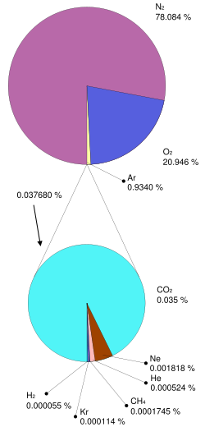
Our Atmosphere
N 78%
O₂ 21%
Ar 0.93%
CO₂ 0.03%
CH₄ 0.0018%
Also variable amounts of water vapour:
H₂O 0.2 to 2.6 %

Slide 41
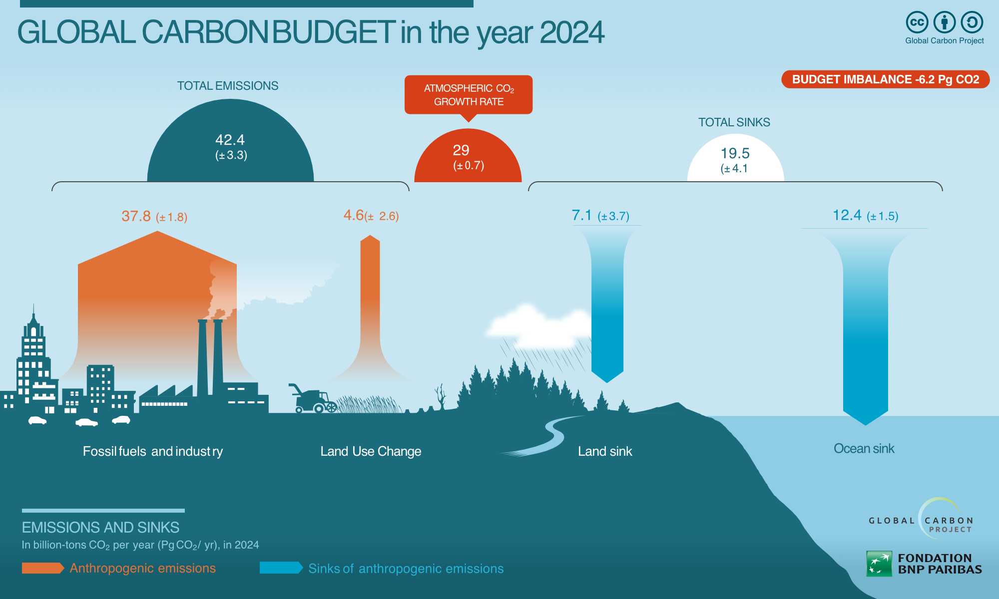
Atmospheric Composition – Carbon Dioxide (CO₂)
Dominant contributor to anthropogenic radiative forcing
Primary sources: fossil fuel combustion (energy, transport, industry)
Cement production via calcination (CaCO₃ → CaO + CO₂)
Land-use change and deforestation reduce long-term carbon sinks
Atmospheric lifetime: centuries (with long tail effects)
Co-benefits of reduction: CO₂ reduction via fossil fuel phase-out also lowers emissions of PM, SO₂, and NOₓ, improving urban air quality and reducing the health effects of air pollution

Slide 42
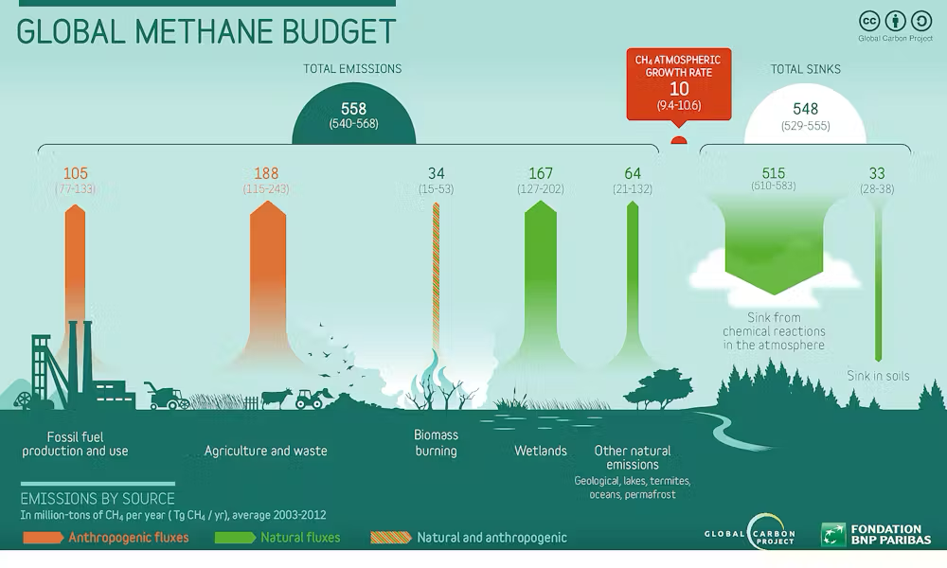
Atmospheric Composition – Methane (CH₄)
Second most important anthropogenic greenhouse gas
Major sources: fermentation in ruminants, rice paddies
Fossil fuel extraction, processing, and distribution losses
Landfills and anaerobic waste decomposition
Short atmospheric lifetime (~12 years)
Co-benefits of reduction: Similar to CO2 but methane controls can reduce ground-level ozone (O₃) formation, improving respiratory health and crop yields.

Slide 43
Atmospheric Composition – Nitrous Oxide (N₂O)
Strong greenhouse gas with significant stratospheric ozone impacts
Primarily emitted from agricultural soils due to nitrogen fertiliser use
Microbial nitrification and denitrification processes
Additional sources: manure management and industrial chemical production
Very long atmospheric lifetime (~120 years)
Co-benefits of reduction: Improved fertiliser efficiency reduces ammonia (NH₃) emissions, lowering secondary particulate matter formation.

Slide 44
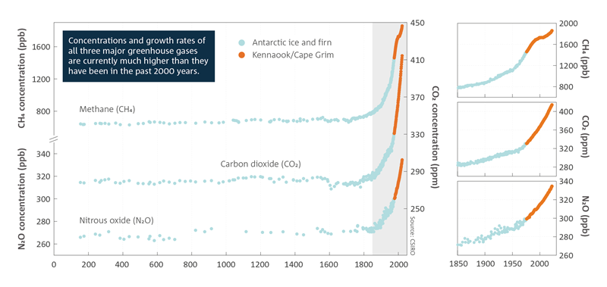
Changing Atmospheric Composition

Slide 45
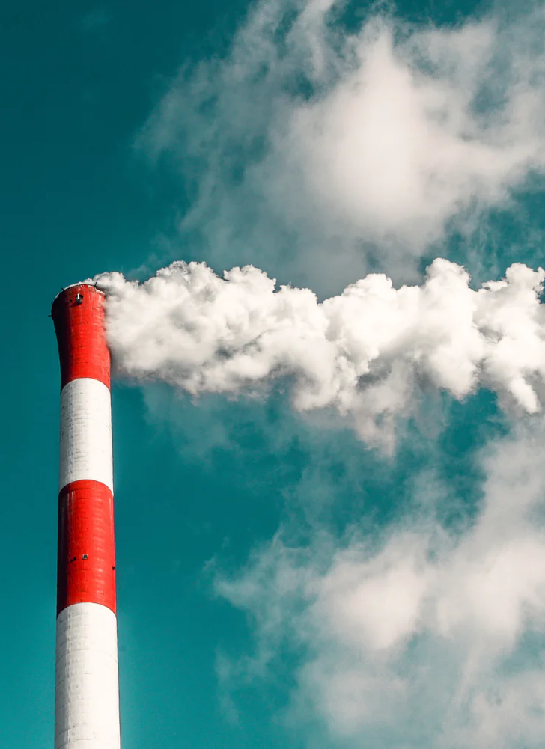
Air-Quality Co-Benefits
Decarbonisation strategies primarily target CO₂ through energy system transformation
Co-benefits include substantial reductions in combustion-related air pollutants, particularly in urban and industrial regions.
Methane mitigation (oil & gas leak reduction, waste management, agricultural practices) delivers rapid climate benefits
Also reduces tropospheric ozone, with immediate public health and agricultural gains.
Agricultural efficiency and fertiliser optimisation are critical for N₂O reduction
Simultaneously decrease ammonia emissions and nitrate pollution, improving air and water quality.
International regulation of F-gases (e.g. Kigali Amendment) limits high-GWP emissions
Often coincides with more efficient cooling technologies, reducing electricity demand and upstream air pollution.

Slide 46
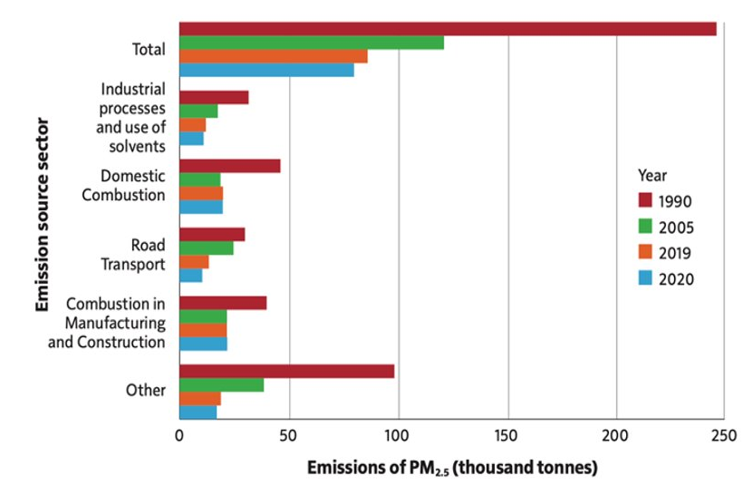
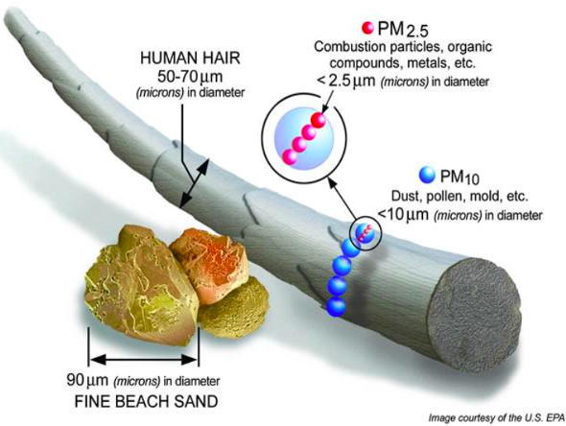
Understanding aerosols
Tiny solid or liquid particles suspended in the air

Slide 47
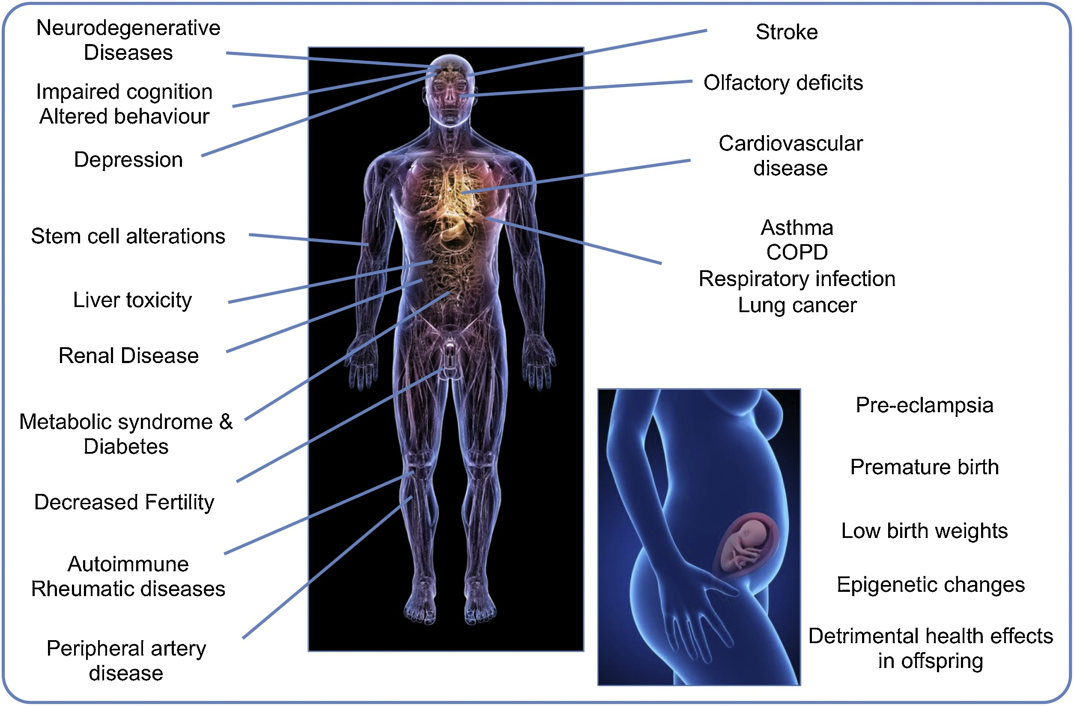
Health Effects and Radiative Forcing
Particle pollution is associated with disease in every organ where it has been studied
Aersols are also a key part of radiative forcing

Slide 48
Lecture Summary
All objects with a temperature above 0 K emit electromagnetic radiation, and both the Sun and Earth behave approximately as blackbody radiators.
Radiation laws (Stefan–Boltzmann and Wien’s Law) explain why hotter objects emit more energy and at shorter wavelengths than cooler objects.
Earth’s energy balance is set by incoming solar radiation and outgoing terrestrial radiation; assuming blackbody equilibrium gives an effective Earth temperature of ~255 K (–18 °C).
The observed global mean surface temperature (~288 K, +15 °C) is higher because of the greenhouse effect.
The atmosphere is largely transparent to shortwave solar radiation, but absorbs and re-emits longwave infrared radiation emitted by the Earth.
Greenhouse gases (e.g. H₂O, CO₂) absorb infrared radiation at specific wavelengths and re-radiate energy in all directions, warming the surface and lower atmosphere.
Differences between planetary temperatures (e.g. Earth, Mars, Venus) illustrate how atmospheric composition and pressure control the strength of the greenhouse effect.
Increasing greenhouse gas concentrations enhance infrared absorption, leading to positive radiative forcing and further warming.

Slide 49
Next Week: Anthropogenic Impacts
In next week’s lecture, you will learn:
How Earth’s energy budget works, and what can disturb it
Human impacts on climate beyond CO₂ and methane
Which anthropogenic drivers matter most for climate change
The physical mechanisms behind these “other” human influences on climate

Slide 50
Global Climate Change
Week 3 – Questions and Answers
Dr Thomas Bannan
Thomas.Bannan@Manchester.ac.uk

Slide 51
Q1.
What is meant by climate change?

Slide 52
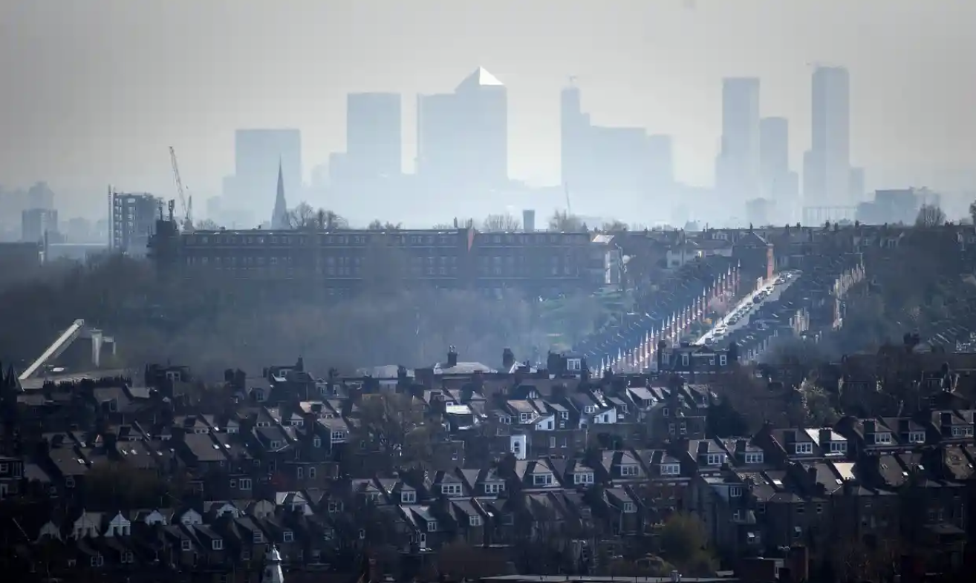
Q2.
Discuss and provide examples of aerosol impacts on air quality and health.

Slide 53
Q3.
Atmospheric particles (aerosols) such as sulfate, nitrate, organic carbon, and black carbon are a major component of air pollution and are linked to adverse human health outcomes. As a result, air-quality regulations around the world aim to reduce particle concentrations, particularly PM2.5. Why might reducing atmospheric particle concentrations lead to clear air-quality benefits but also create climate disbenefits? What effects might this have on the climate system?

Slide 54
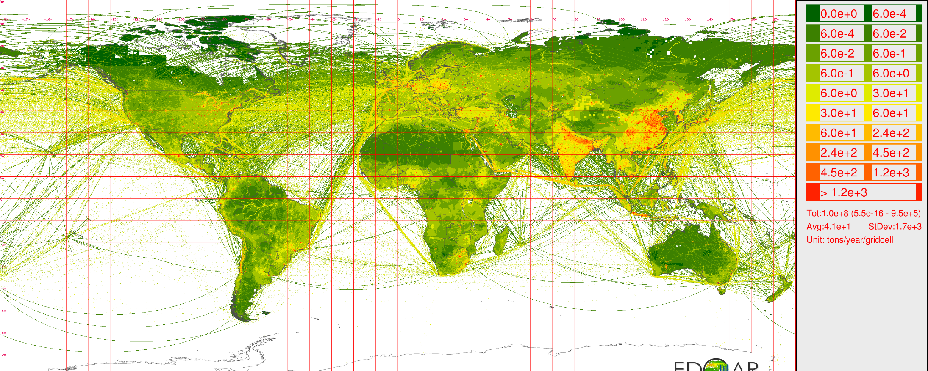
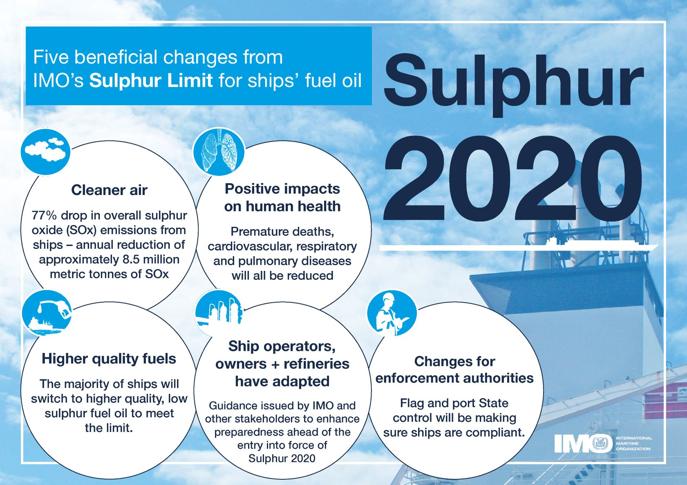
Q4.
Sulfate aerosols originates from atmospheric oxidation of SO₂. This is a global picture of SO₂ emissions. Recently new legislation was passed to reduce SO₂ emissions from shipping.
What impact might this have? What could the unintended consequences of this be? It is worth improving air quality over the ocean?

Slide 55
Q5.
Ozone absorbs both UV and IR radiation. What is the effect on the environment of each?
How would the climate differ if the IR absorption band of ozone didn’t exist?

Slide 56
Q6.
Can you use the graph below to estimate the surface temperature of the sun?

Slide 57
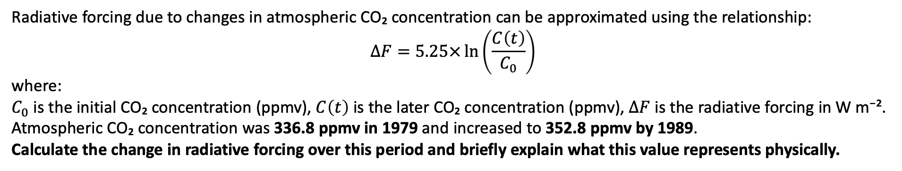
Q7.
Radiative forcing due to changes in atmospheric CO₂ concentration can be approximated using the relationship:
$$ΔF=5.25×\ln\left(\frac{C\left(t\right)}{C_{0}}\right)$$
where:
$C_{0}$ is the initial CO₂ concentration (ppmv), $C\left(t\right)$ is the later CO₂ concentration (ppmv), $ΔF$ is the radiative forcing in W m⁻².
Atmospheric CO₂ concentration was 336.8 ppmv in 1979 and increased to 352.8 ppmv by 1989.
Calculate the change in radiative forcing over this period and briefly explain what this value represents physically.

Slide 58
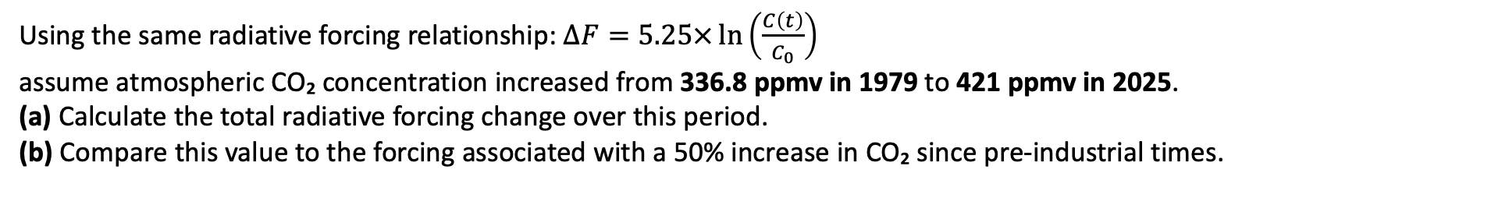
Q8.
Using the same radiative forcing relationship: $ΔF=5.25×\ln\left(\frac{C\left(t\right)}{C_{0}}\right)$
assume atmospheric CO₂ concentration increased from 336.8 ppmv in 1979 to 421 ppmv in 2025.
(a) Calculate the total radiative forcing change over this period.
(b) Compare this value to the forcing associated with a 50% increase in CO₂ since pre-industrial times.
Notes:
(

Slide 59
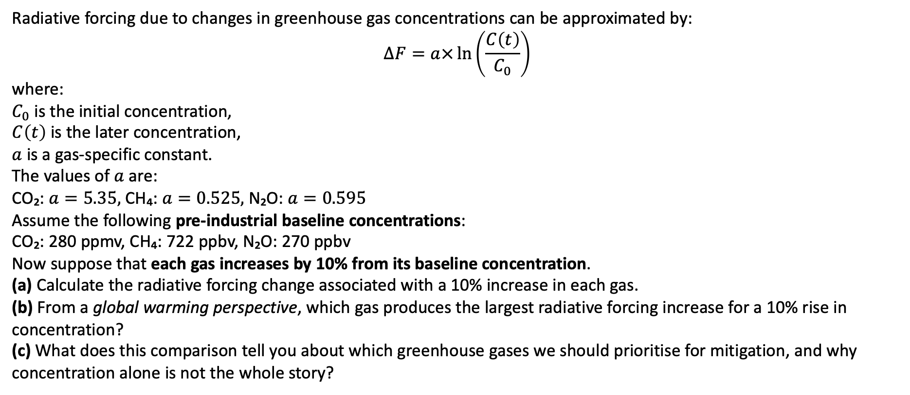
Q9.
Radiative forcing due to changes in greenhouse gas concentrations can be approximated by:
$$ΔF=a×\ln\left(\frac{C\left(t\right)}{C_{0}}\right)$$
where:
$C_{0}$ is the initial concentration,
$C\left(t\right)$ is the later concentration,
$a$ is a gas-specific constant.
The values of $a$ are:
CO₂: $a=5.35,$CH₄: $a=0.525,$N₂O: $a=0.595$
Assume the following pre-industrial baseline concentrations:
CO₂: 280 ppmv, CH₄: 722 ppbv, N₂O: 270 ppbv
Now suppose that each gas increases by 10% from its baseline concentration.
(a) Calculate the radiative forcing change associated with a 10% increase in each gas.
(b) From a global warming perspective, which gas produces the largest radiative forcing increase for a 10% rise in concentration?
(c) What does this comparison tell you about which greenhouse gases we should prioritise for mitigation, and why concentration alone is not the whole story?

